Slide 1
Book Library Management System
book2employee
Team 2
Ash, Boram, Bernice, Roxana, Natalia
Notes:
Guys please change this + theme as you want
2-4-U
Library2U
Books2Employees
Books-R-Us
Speaker: Bernice

Slide 2

Introduction
Our Project
Why we chose this task
Git - Version control software
Initial planning + database structure
Architectural Design
Testing
TCER, POSTMAN
Web Application Demo
Challenges and how we solved those
Future Developments
Notes:
Git = version control platform
Talking through what we will go over in the presentation
Speaker: Bernice
Next speaker: Ash
Welcome to group two’s presentation by myself Bernice, Ash, Boram, Roxana and Natalia. Our group project is based on a Library Manage
Our reason for choosing this project is because throughout our training we have worked on both employee and book projects and we decided that building building a library management we could combine everything together
tracking changes in any set of files, usually used for coordinating work among programmers collaboratively developing source code during software development.

Slide 3
Our roles
Skeleton structure, POJOs and databases - everyone
Ash
Employee-Service Microservice implementation + testing
Return book button implementation
Search for books with input
Few features / parts of Book-Library-MVC service layer implementation
Boram
Book-Library-MVC controller layer implementation
Return book button implementation
HTML templates
CSS
Bernice
Book-Library-MVC controller layer implementation
Login/Logout controller implementation
HTML templates
CSS
Roxana
Book-service layer (service + dao +resource)
Search for books with input implementation
Borrow book implementation
View borrowed books
Natalia
Book-service layer (service + dao + testing)
library-mvc [service impl (the methods) + dao bits]
Testing library mvc service layer + dao layer
Return - search for books (controller + html bits)
Notes:
Speaker: Ash
Next speaker: Roxana

Slide 4
Scope of Project
Login
View all books available to be borrowed
Borrow a book
Return a book
View all the books that the user has already borrowed
Search books by keyword
All pages allow the user to logout or return to main menu
Notes:
Speaker: Roxana
Next speaker: Nat

Slide 5
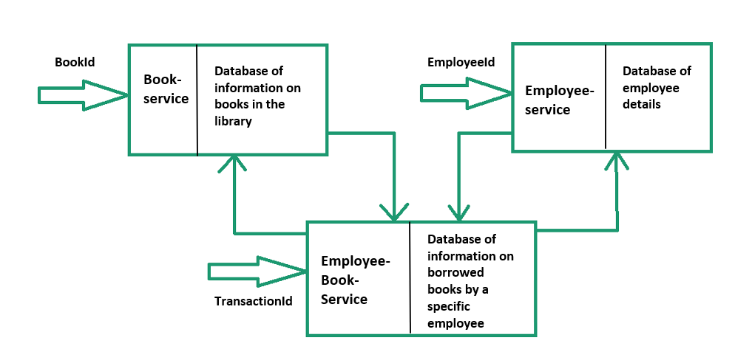
Design Plan
(MVC)
Notes:
Speaker: Nat
To produce a solution for our problem statement, we started by making a design plan on which to base our web app off of.
We have 3 databases/microservices;
book service providing information on the books in the library
Employee service which stores the data of the employees allowed to log into the library app
Employee-book-service which stores the borrowed books for a particular employee (this is our MVC- model view controller) which is also attached to its own database
The 1st 2 databases are independent of each other where as the 3rd (employee-book) is composed of information from both book and employee databases (as well as its own information regarding return dates and late fees attached to a borrowed book transaction)
The arrows connecting the above book and employee services to the employee-book service represent the interactions between the services (such as a book being borrowed from the book-service and stored in the employee-book database then the number of copies of that book in the book-service will decrease)
Boram will speak more on the connections between these 3 services in terms of the employee login, borrow book and return book functionalities

Slide 6
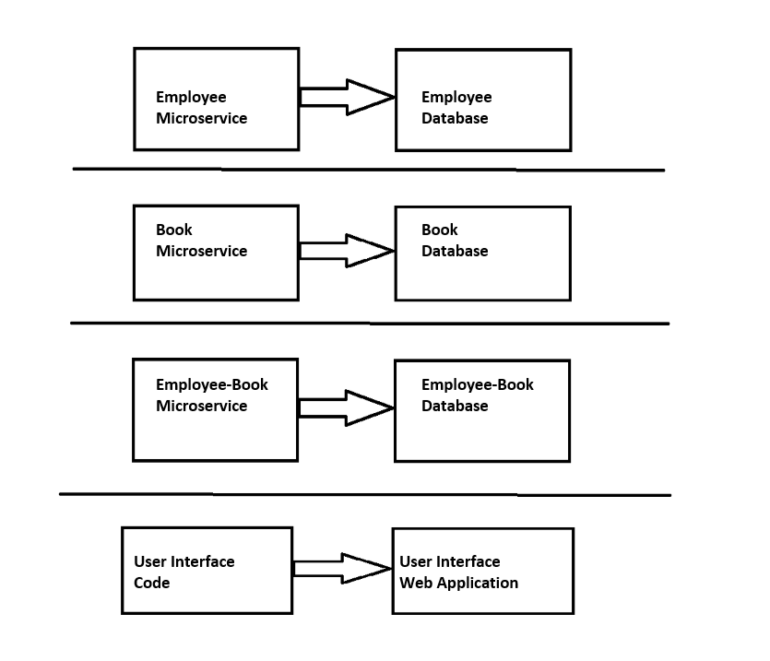
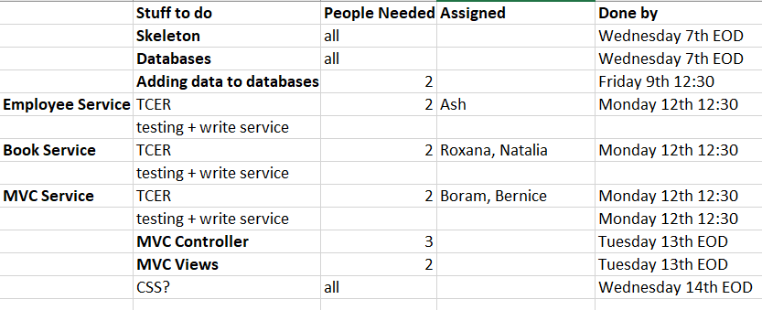
Initial Planning and Architecture
Notes:
Speaker: Nat
We used the microService approach (where each section of the diagram is a microservice) and developed each microservice using TDD (tested driven development)
We did this to break up our problem statement so that a few members of our team can focus on each section of our app, developing the different sections in parallel;
The employee and book databases being independent of each other and the employee-book database pulling data from the above 2 databases however also having its own database
which we call ‘library’ hence this microservice also needed its own functionality
This was our initial plan to develop these microservices in parallel allocating a couple of us to each service, however in the end we all worked on various different functionalities within the app, not restricted to the initially assigned roles
Next speaker: Boram

Slide 7
Database
Employee
int employeeId
String employeeName
String password
int bookQuantity
Library
String transactionId
int employeeId
String employeeName
int employeeId
String bookType
LocaDate issueDate
LocaDate expectedReturnDate
LocaDate returnDate
int lateFee
Int numberOfCopies
Book
int bookId
String bookName
String bookType
String bookAuthor
String bookDescription
int numberOfCopies
Login
View / Search
Book Catalogue
Borrow / Return Book
View Borrowed Books
Notes:
None of the databases are connected so maybe not an er diagram?
NEED TO UPDATE DIAGRAMS + insert
How the different parts of the app are connecting-
E.g. app needs employee to login- employee borrowing book from library (so we have 3 different dataset)
Remove the column names not needed- just arrows on the flow of the app from when the user logs in
Speaker : Boram
Next speaker: Bernice

Slide 8
Functionality 0. login
User is able to insert login credentials:
Employee id
Password
The user is restricted from inputting invalid data format or blank data
Error message is displayed, should the login details be invalid
The user is able to attempt another login
Should the login be successful, the user is taken to the main menu page
Notes:
Speakers: Bernice
Next speaker: Ash

Slide 9

Functionality 1. Borrow book
Allows the user to borrow a book
Library copies decreased, user copies increased
If there are no copies available for that book an error message is displayed
Limits the quantity of books borrowed by the employee to 5
Challenge: pull through book id controller side
Notes:
Cap on number of books (subsection)
speaker : Ash
Next speaker: Nat

Slide 10

Functionality 2: Returning a book
Books can be issued for 7 days
A late fee is applied dependent on how late the book is returned
Type of Book | Late Fee (Rupees per day)
Data Analytics | 5
Technology | 6
Management | 7
Notes:
speakers : Nat
To return a book, the employee will press the return book button from their list of borrowed books (they can shift through this list to search by the type of book and date that they borrowed the book)
This return book functionality then calculates any late fees based on the type of book and how many days late the employee is returning the book (baring in mind that late fees apply to more than 7 days after borrowing the book) and these late fees/no late fees are displayed on the screen
As a book is being returned, the book is put back into the library of book (which is our book-service), hence the number of copies of that book in the library increases by 1
Also in the database of list of books borrowed by the employee (our employee-book service), the number of copies of this book decreases by 1 and if this is the last of that book being returned, the that record is deleted from the database of employee books borrowed.
For example, say we have 2 copies of twilight borrowed, and we return a copy, then in the books borrowed database we will have 1 copy left, if we then return our other copy of twilight, there is now 0 copies of twilight in our borrowed books so that record is deleted from the borrowed books database
Challenges faced when developing this functionality:
When the employee presses the return book button for a particular book, we need to keep track of which book this is - this was done by adding the uri which included the transaction id of the book that the employee wants to return, so we could then make the return for the book of choice
In addition to this, we faced challenges with updating the book copies in the library and resolved this by making use of the rest API functionality (the functionality which allows us to request access and use data from other microserves)
Next Speaker: Roxana

Slide 11

Functionality 3. View borrowed books
View all current borrowed books
Displayed fields:
Transaction Id
Book Id
Book Type
Issue Date
Expected Return Date
Number of copies borrowed
Return a book button
Notes:
Speakers: Roxana
Next Speaker: Boram

Slide 12

Functionality 4. See book catalogue
Displays all books available to be borrowed in the library
Displayed fields:
Book Id
Book Name
Book Type
Author Name
Book Description
Number of copies available
Borrow a book button
Notes:
Speakers: Boram
Next Speaker: Ash

Slide 13

Functionality 5. Search book catalogue
Allows user to search for a specific book by keyword
Restricting user from inputting a single character or leave it blank
Allowing borrow book (from the borrow book functionality)
Display message if no book containing keyword found
Notes:
Speakers: Ash
Next Speaker: Boram

Slide 14
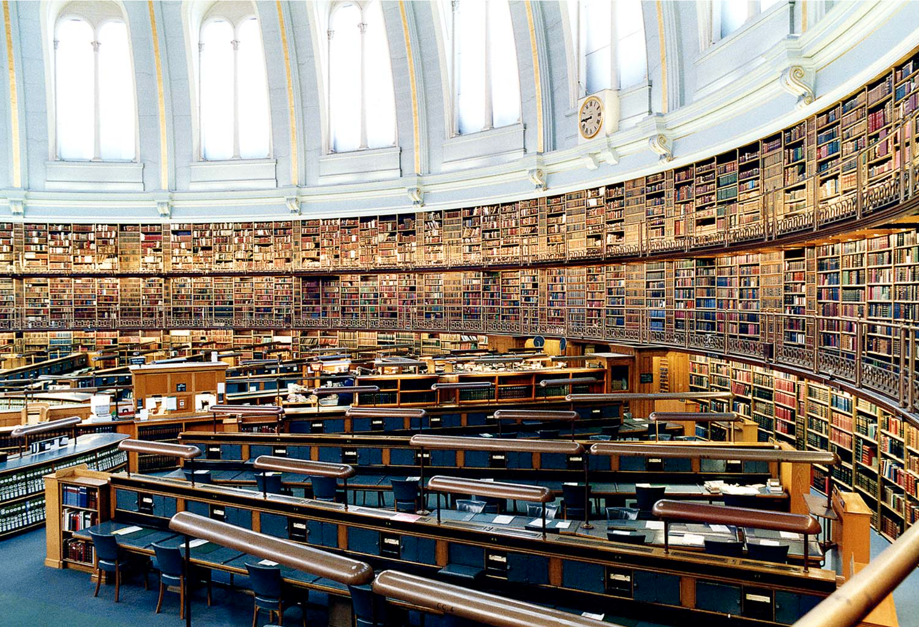
Functionality 6. CSS
Applied landing page image
Applied background color
Data has been organized into tables to aid readability
Descriptive icons have been used to improve user experience
Color change when hovering over fields
Candida Höfer | British Library London | 1994
Notes:
Speaker: Boram
Next speaker: Nat

Slide 15
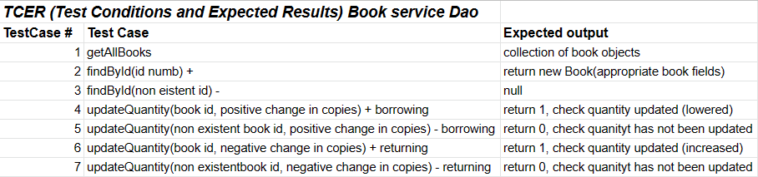
Testing
Notes:
Speaker: Nat
Next Speaker: Roxana
We tested the service and persistence layers of all of our microservices as we developed them
When testing the service layers for the book and employee microservices, we mocked the databases that the microserves were connected to
We also mocked the borrowed books database when testing the service layer of the MVC app (the employee-book service) and when testing the other service functionality of the MVC which involved accessing data from the employee and book databases, we used the standard JUnit testing (with no mocking of the databases)
Here is an example of the test conditions and expected results of the book service persistence layer.
We did these TCERs for all our tests and after handling our errors, all tests passed successfully.

Slide 16
Sit Back, Relax, and Enjoy A Demo of Our Application!
book2employee
Notes:
Talk about CSS here as well
Put in records to show the late fee (multiple books which have the fine)
Figure out which records to click on to show what
Speaker: Roxana
Next Speaker: Bernice

Slide 17

Challenges
Planning challenge (entities and databases)
Overcame: Taking an incremental approach- we were very agile- adaptational
Notes:
TRY TO EXPLAIN IN NON-TECH WAY
Speaker: Bernice
Next speaker is everyone so you can just say next slide
Notes: challenge
For agile / adaptational you can mention how sujata (our client) requested a search function to be added as well during a demo of the project and we added it

Slide 18
Future Developments
Extend the return date on a book
Admin - add book, delete book, add employees etc.
User Register
Submitting a request to add a book
Different sorting methods in book catalogue
Choose how many copies of a book they want to borrow
Include employee’s book history
Lock the user’s account should they enter their credentials wrong three times
Notes:
Speakers: Ash, Boram, Bernice, Nat
Nat: Could also add a history of the employee- all the books they have returned and borrowed on which date- so each time an employee logs in and does an action, our program could keep track of their actions via a list/ writing to a file and having an option to view this history in the menu. + restricting the number of login attempts for an employee
Renewing a book (Bernice)
Admin - add book, delete book, add employees etc. (Ash)
User Register (Ash)
Submitting a request to add a book (Ash)
Choose how many copies of a book they want to borrow (Boram)
Include employee’s book history (Nat)
Lock the user’s account should they enter their credentials wrong three times (Nat)
Submitting a request to add a book when it doesn’t appear in search?? Using file input output

Slide 19

Thank you for listening!
Any questions?

